Slide 1









Why is eHealth so hard?
#LCED16
Hildegard Franke freshEHR Clinical Informatics
August 2016

Slide 2
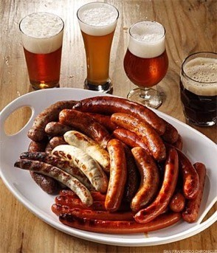




About me
Hildegard Franke
Health informatician
Director freshEHR Clinical Informatics
GP system supplier background
Training
Clinical Modelling Product Management Terminology
‘archetype wrangler’ and ‘hacker’

Slide 3

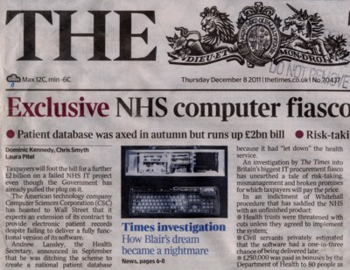


Is it so hard?
The banks can do it …. why not healthcare ?

Slide 4







pkenrkifnfliifgflig”
“Crunchy”“T“Nasty”“Hair“Gnarly”“Messy”ricky”y”
Su
Health information is “
Healthcare data is highly complex and ever changing
Biological Cultural Political
Huge and segmented populations Safety-critical
Poor infrastructure
Getting good requirements from clinicians is hard

Slide 5

Healthcare is powered by information
To facilitate immediate care
Aide-memoire for clinician Automate business processes Trigger decision support
To facilitate review of care quality
Quality registers / audit
To inform healthcare management To inform research
‘Big data’, analytics Clinical trials

Slide 6
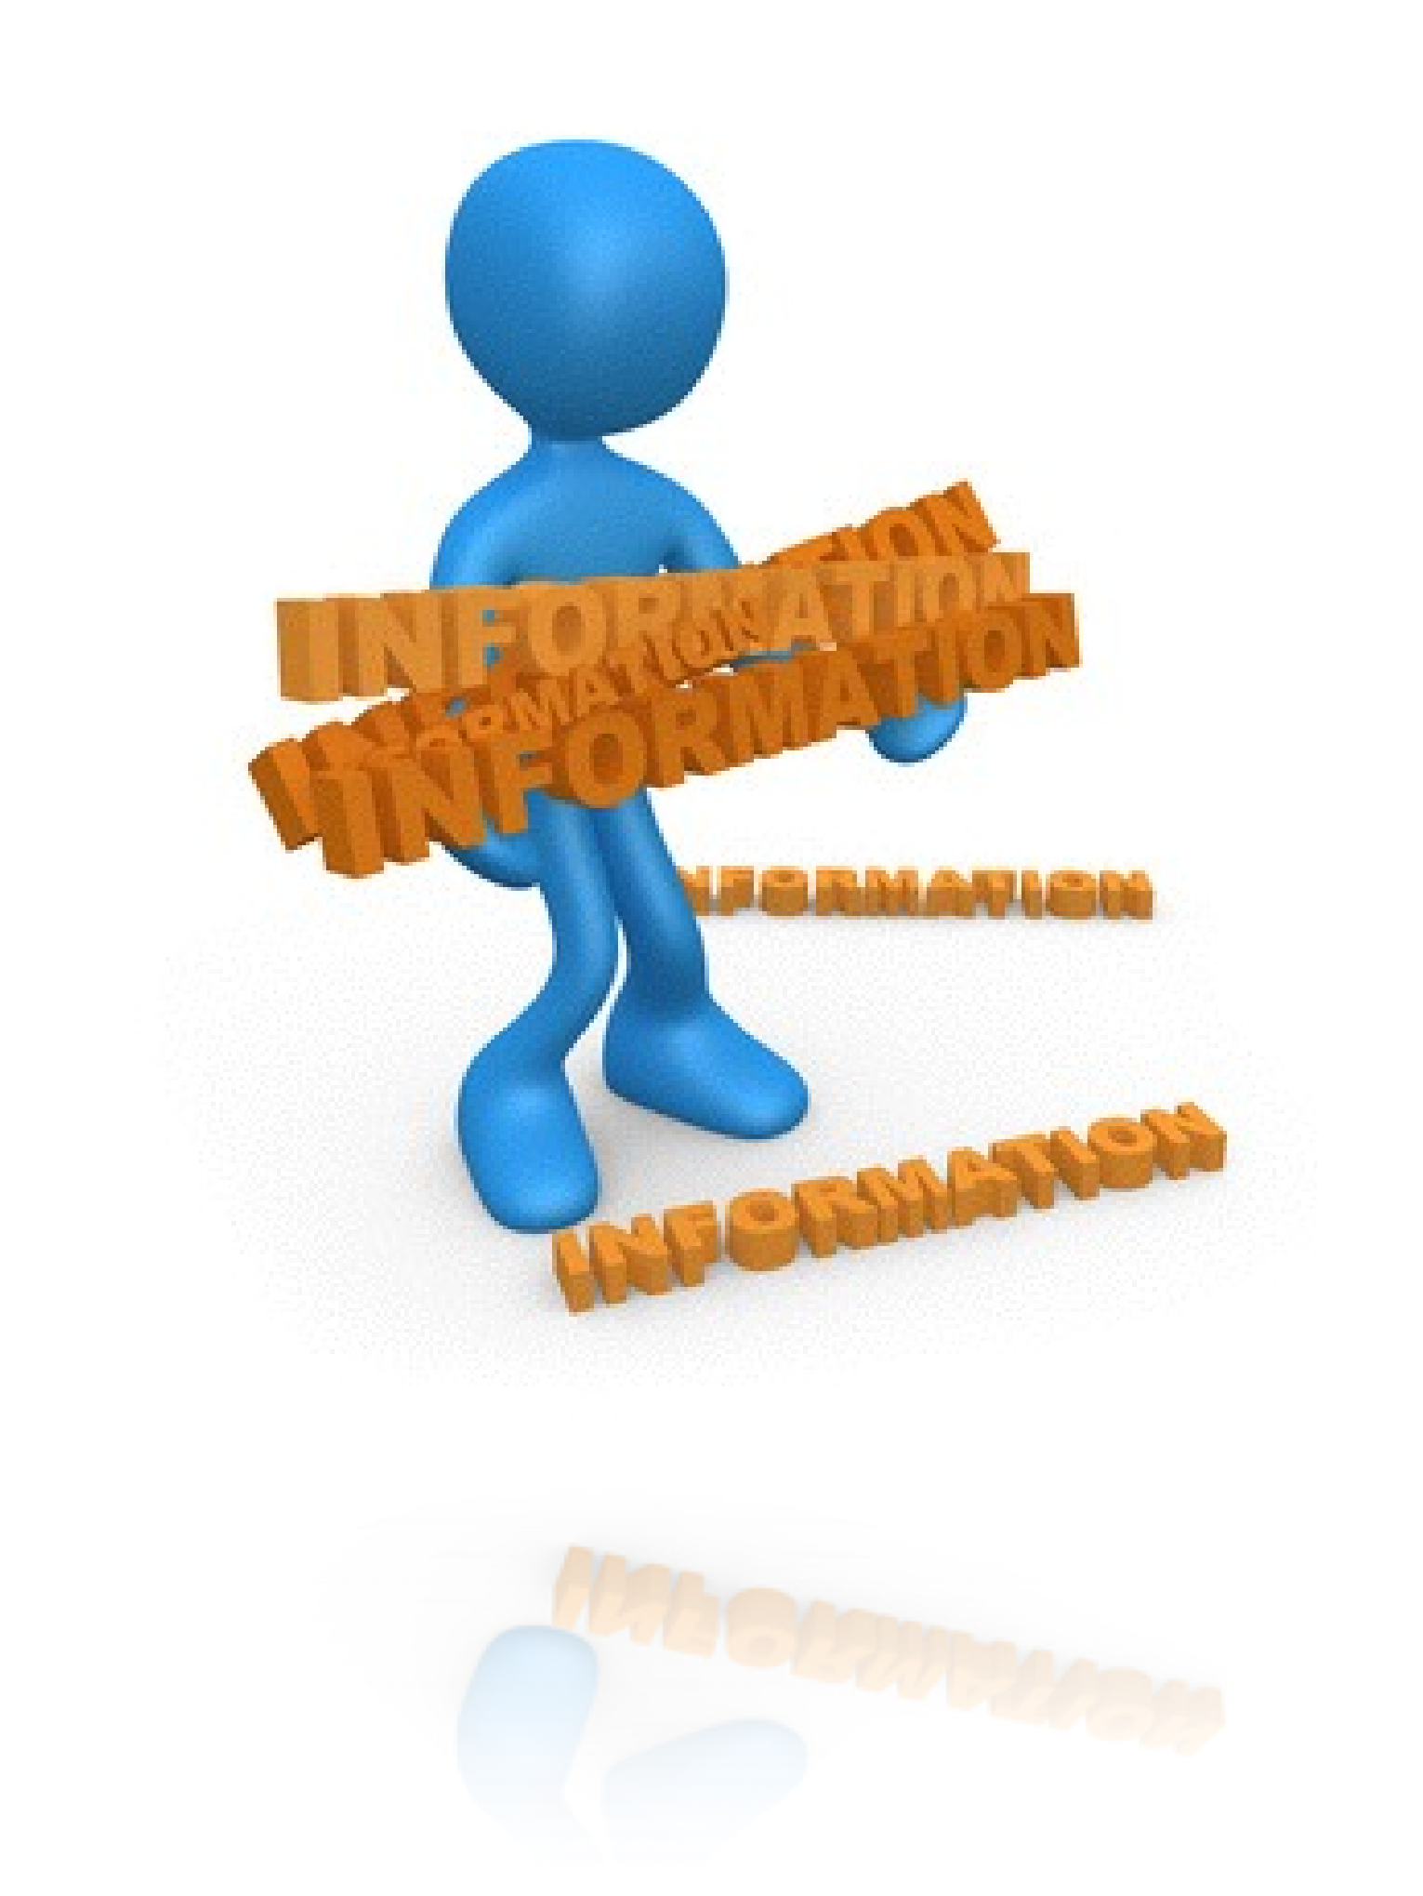
Why is health information so hard?
Very different kinds of information Biological concepts Documentation of care
Compressed, summarised information
Reporting
Making sense of complex care
Large number of complex datatypes
not just string, numeric, url, date

Slide 7

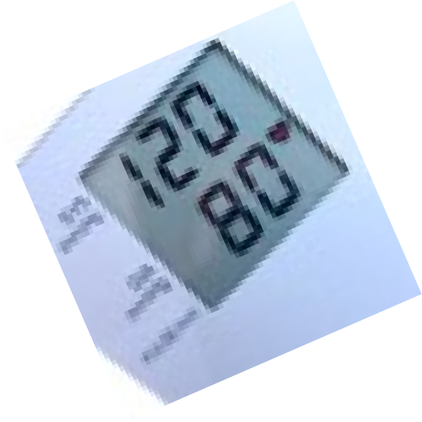



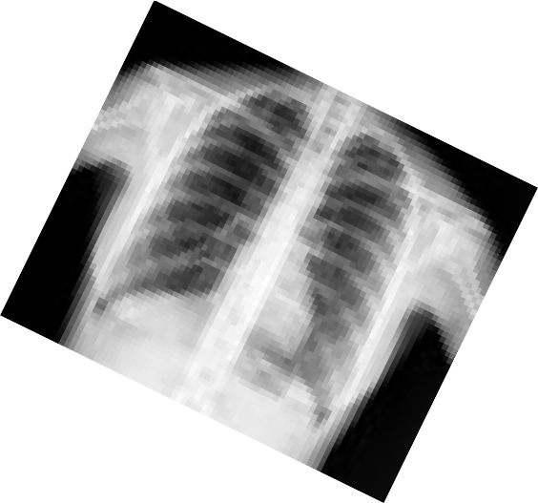









Health information
Biological ‘real world’ concepts
Symptoms, examinations Lab tests, imaging results Illnesses, procedures Medications, devices
Documentation of care
Point of care (Diagnosis name, date of onset, date diagnosed, grade/stage)
Medico-legal context (who, when, why, what, how)

Slide 8

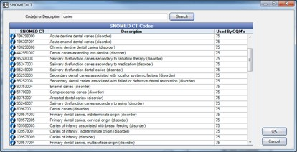

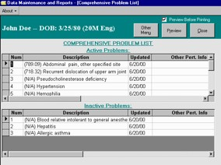
Health information
Compression and processing of health information
Registries Research
Handling ‘health status’
‘Curated’ problem lists

Slide 9




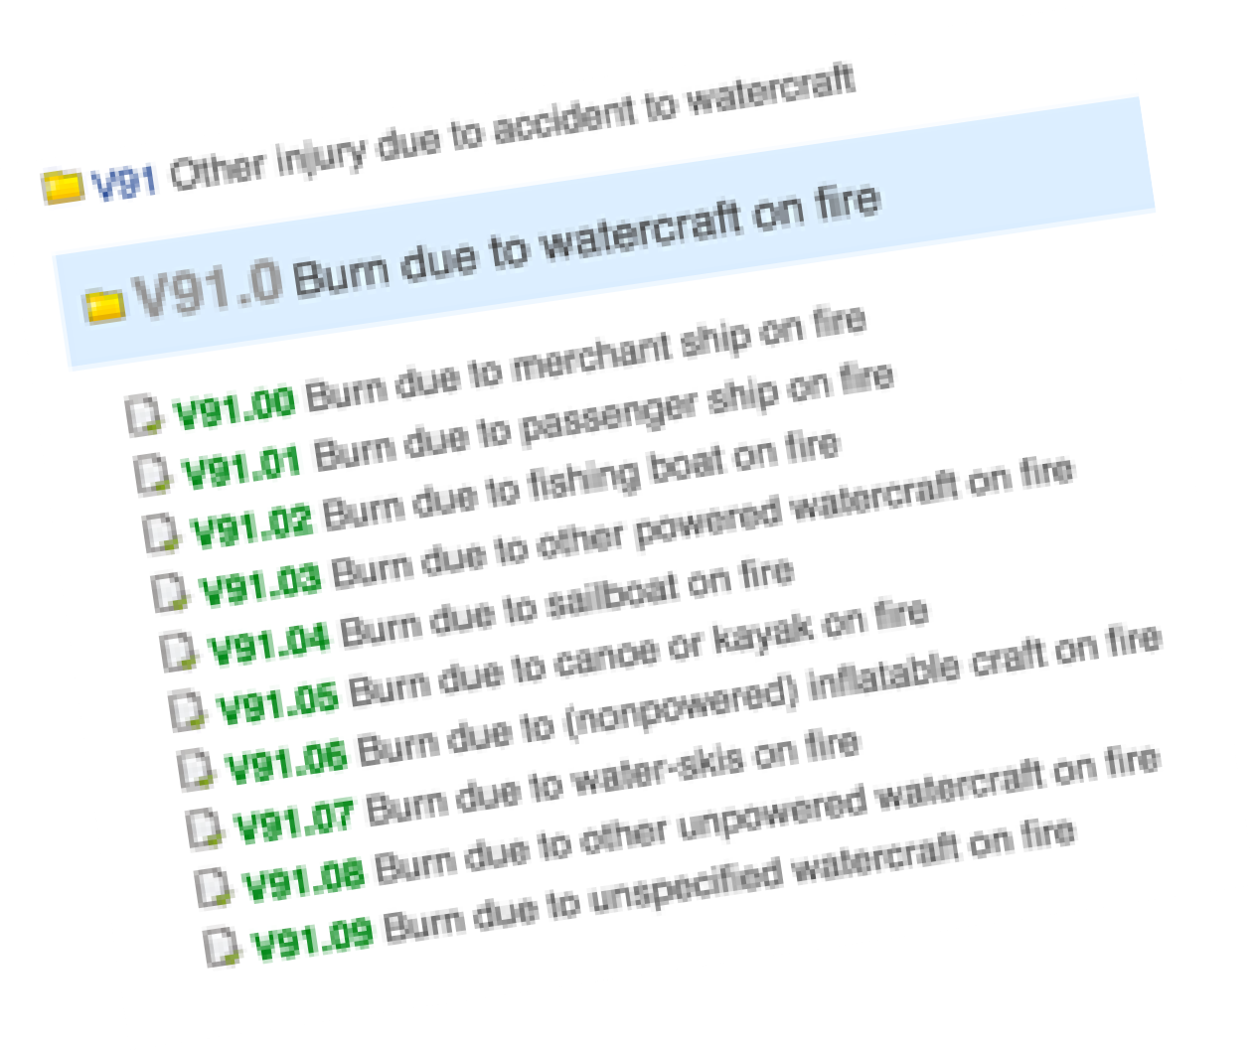



Complex datatypes
Plain text Coded terms
external ‘ reference’ terminologies local codes and mappings
Dates and times Durations Quantities Interpretations

Slide 10
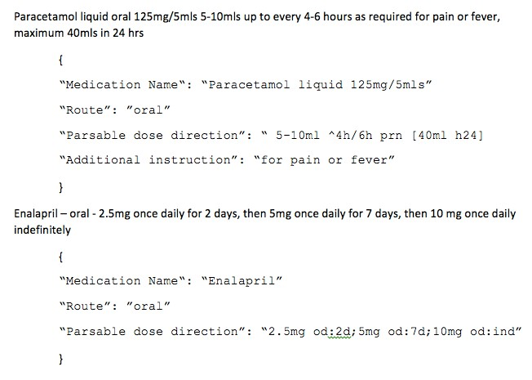

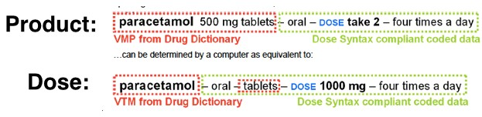

Medication ‘dose syntax’
“Co-codamol 8mg/500mg/5ml oral
How do we cope with product
s^{H}uºs^{w}pe^{ca}n^{n}si^{w}o^{e}n^{c}5^{ap}-1^{tu}0remªls^{pr}4e-^{s}6^{c}h^{rip}o^{t}u^{io}r^{n}ly^{lik}f^{e}or 7 days
versus dose prescribing?
_{for}“_{p}Co_{a}-c_{in}o,da_{m}m_{a}ol_{x}8_{i}m_{m}g_{u}/5_{m}00m₄g₀/5_{m}m_{l}l_{s}or_{d}al_{a}s_{i}u_{l}s_{y}p”ension
5-10mls 4-6hourly for 7 days for pain, maximum 40mls daily”
can we cope with dose vs product cribing
How pres

Slide 11
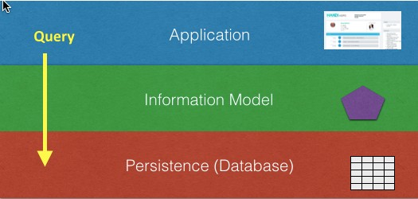

Information model is critical

Slide 12




Health terminologies
Needed to represent biological and scientific concepts
500,000+ SNOMED CT
concepts
even more relationships which support ‘inferencing’
e.g. Diabetes Mellitus Type 1 is_a metabolic disease AND is_a disease of the pancreas

Slide 13

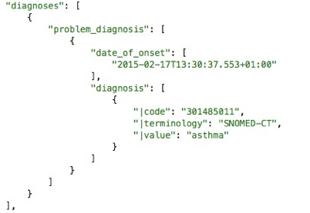
A mixed economy
In reality we need
‘Clinical content’ models
underpin persistence underpin API / messaging
+ Terminologies
label/ classify biological concepts power inferencing
Blended approach
no ‘one true way’

Slide 15

What is a CDR?
the openEHR eHealth
platform
#LCED16
Ian McNicoll
Co-chair openEHR Foundation freshEHR Clinical Informatics Ltd.
August 2016

Slide 16

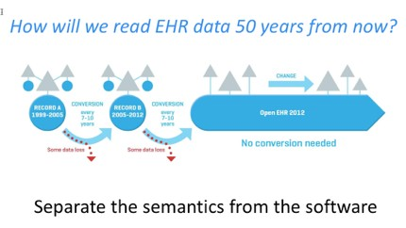
openEHR - key goal
Provide open specifications for an eHealth platform
keeping the data in any openEHR system completely interoperable
regardless of programming language
regardless of human language
regardless of internal database technology

Slide 17


Slide 18

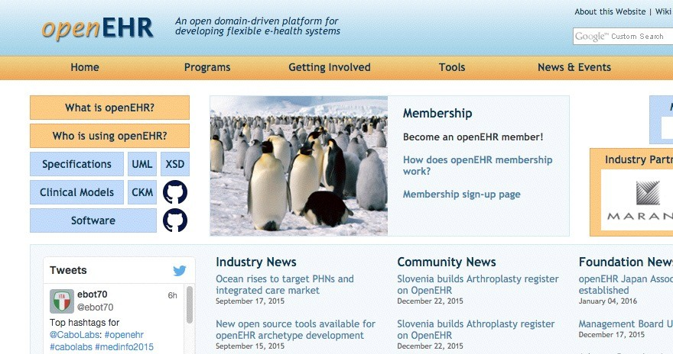
www.openehr.org

Slide 19




















‘CDR’-based architecture
App
App
App
open Information Model

Slide 20




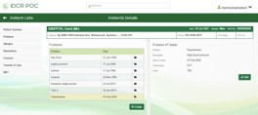
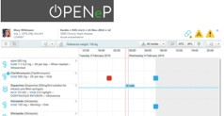
‘CDR’-based architecture
open Information Model

Slide 21
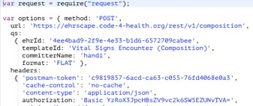

‘CDR’-based architecture
openEHR Rest API + AQL

Slide 22


‘CDR’-based architecture
openEHR Rest API + AQL
openEHR CDR

Slide 23
‘CDR’-based architecture
openEHR Rest API + AQL
openEHR CDR

Slide 24
‘CDR’-based architecture
openEHR Rest API + AQL
openEHR CDR

Slide 25

‘CDR’-based architecture
openEHR Rest API + AQL
openEHR CDR

Slide 26


‘CDR’-based architecture
openEHR Rest API + AQL
openEHR CDR

Slide 27
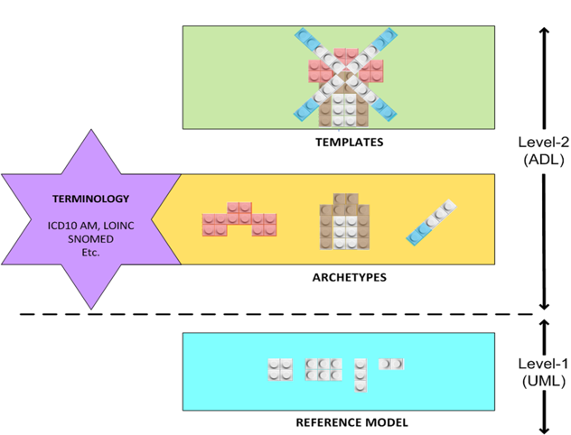
Two-level information modelling

Slide 28
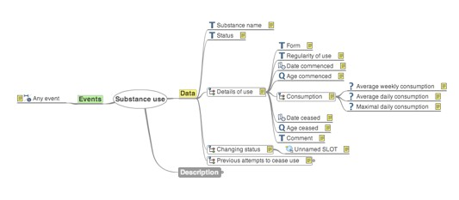
openEHR: Archetypes
open source computable models of discrete clinical concepts
Familiar components of a health record
Blood pressure, Body weight Medication order, Family history Urea, Creatinine results
‘Maximal dataset’
Capture as many clinical perspectives as possible

Slide 29

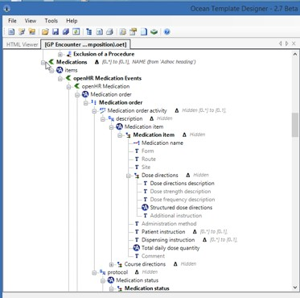
openEHR: Templates
Templates deliver the datasets by aggregating archetypes together
Key clinical endpoint and start point for generation of technical artefacts
i.e. openEHR archetypes and templates can be used directly
Class libraries, Message schema GUI skeletons, API Profiles

Slide 30

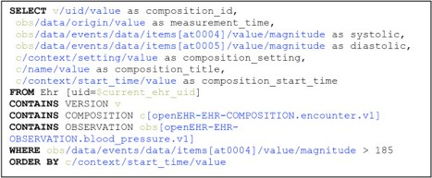
AQL: Information-model querying
Information model querying, independent of the actual database querying
vendor/technology neutral querying
To query an openEHR system you only have to know which archetypes are in use.

Slide 31

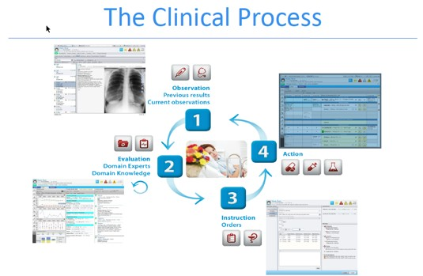

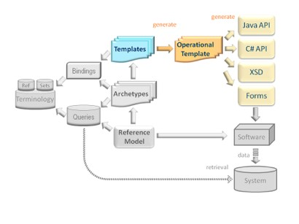
Clinical Information models factory

Slide 32
‘open platform’ architecture
App
App
App
open Information Model

Slide 33
‘open platform’ architecture
open Information Model

Slide 34
‘open platform’ architecture
openEHR Rest API + AQL

Slide 35
‘open platform’ architecture
openEHR Rest API + AQL
openEHR CDR

Slide 36
‘open platform’ architecture
openEHR Rest API + AQL
openEHR CDR

Slide 37
‘open platform’ architecture
openEHR Rest API + AQL
openEHR CDR

Slide 38
‘open platform’ architecture
openEHR Rest API + AQL
openEHR CDR

Slide 39
‘open platform’ architecture
openEHR Rest API + AQL
openEHR CDR

Slide 40








The good news…
You do not have to build your own openEHR back- end ‘CDR’…
over 10 providers of openEHR CDR services
the APIs are compact and easy to use once you understand the basic concepts

Slide 41



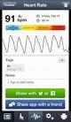





















SMARTPlatforms Pluggable Webapp API
HL7 FHIR
Clinical Content Exchange NHS API
Clinical leadership PRSB
Detailed Clinical Content Development
Archetype+ SNOMED Clinical Content definitions
Non openEHR systems
‘inVivo’ Datastore API
HSCIC
Terminology Centre

Slide 42
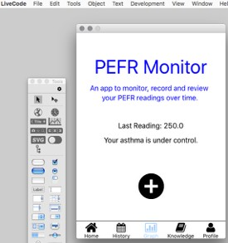

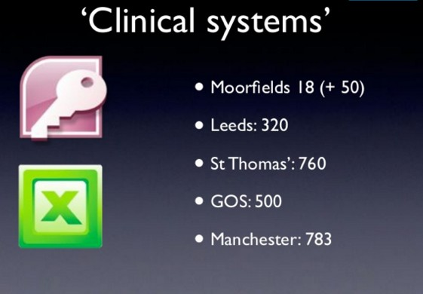


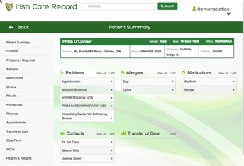
‘feral’ systems

Slide 43

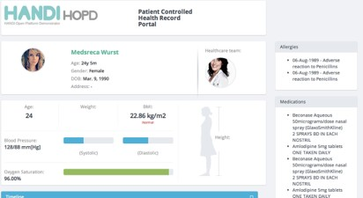

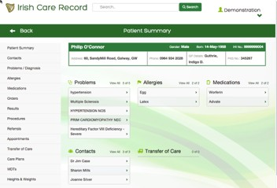
openEHR CDR summary
Designed for storing and querying rich clinical dataset
New content is defined directly by clinicians and can be immediately uploaded into the clinical data repository
Vendor-neutral data models Technology-neutral data models
Vendor-neutral data querying Technology-neutral data querying

